Slide 1
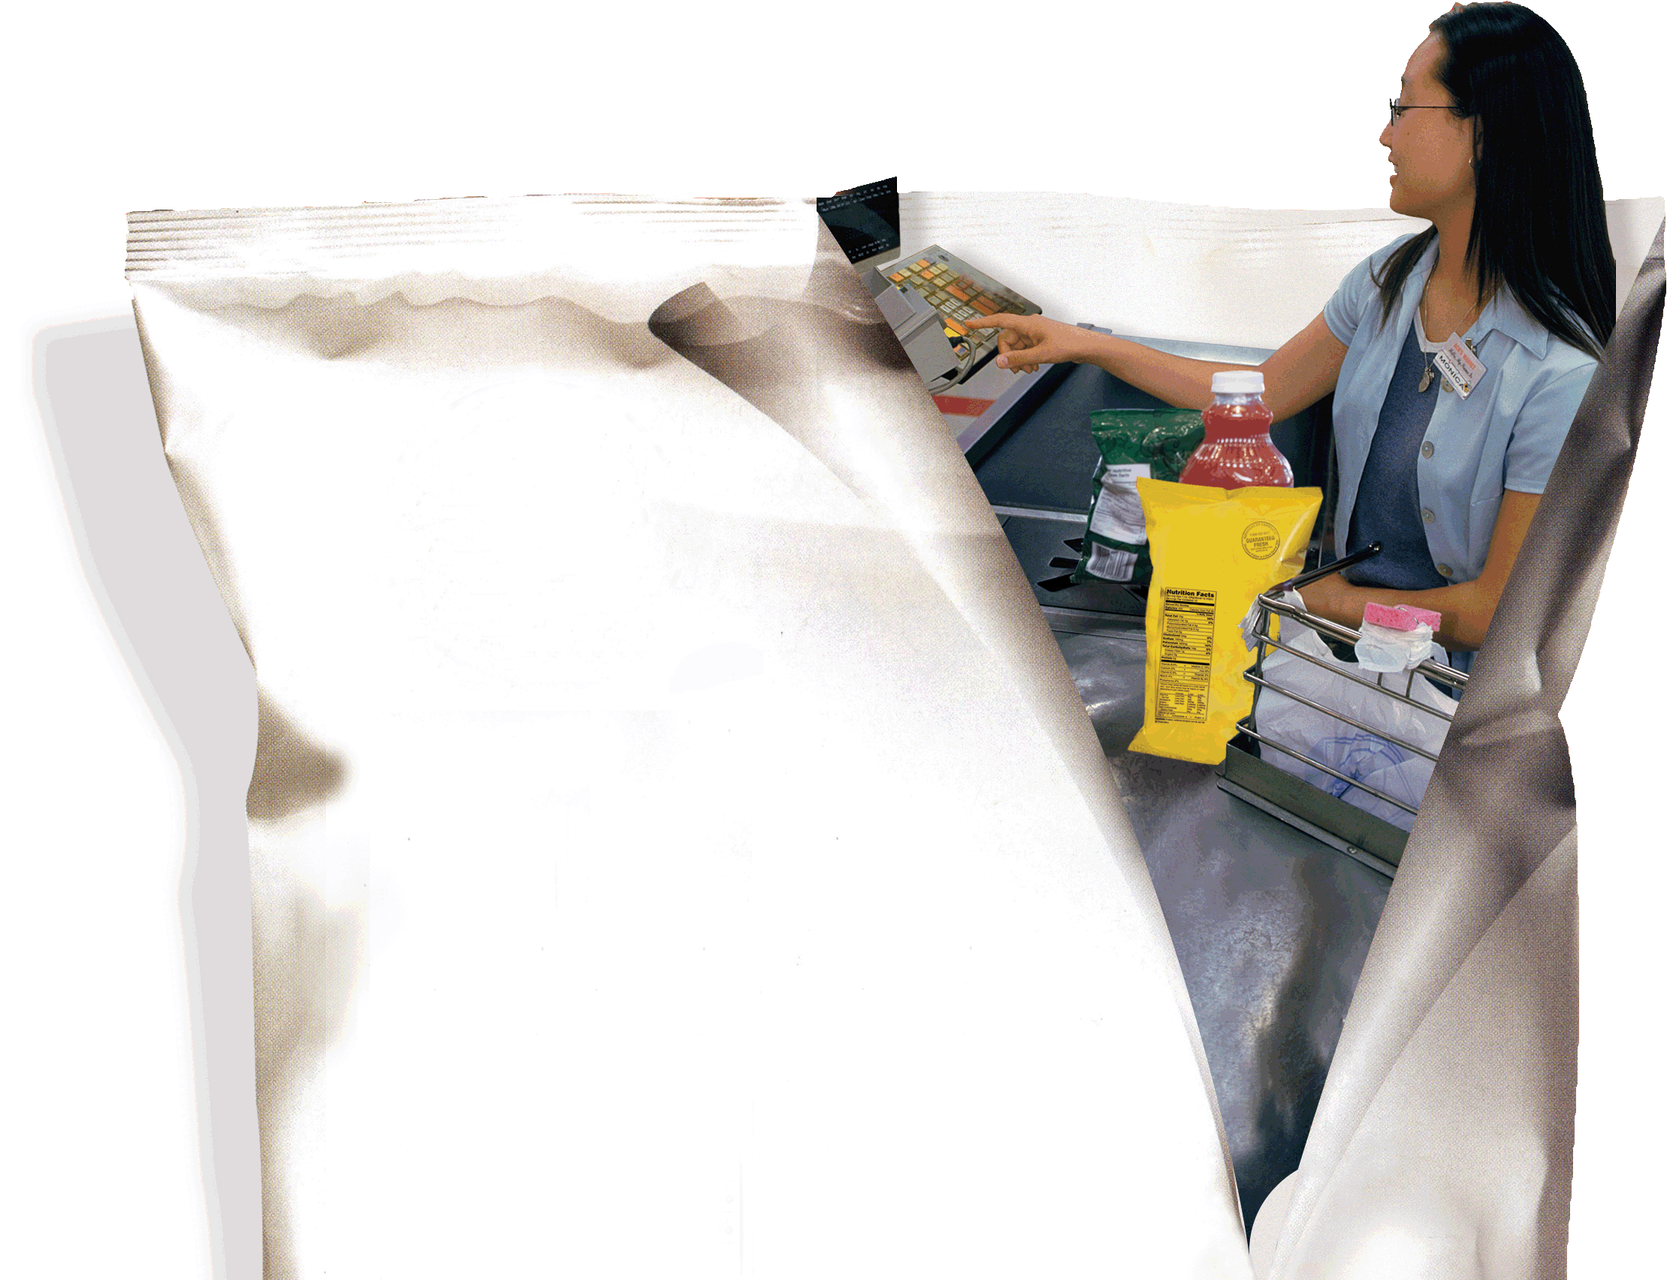
B
Linear Programming
PowerPoint presentation to accompany
Heizer and Render
Operations Management, 10e
Principles of Operations Management, 8e
PowerPoint slides by Jeff Heyl

Slide 2
Outline
Why Use Linear Programming?
Requirements of a Linear Programming Problem
Formulating Linear Programming Problems
  Shader Electronics Example

Slide 3
Outline – Continued
Graphical Solution to a Linear Programming Problem
  Graphical Representation of Constraints
  Iso-Profit Line Solution Method
  Corner-Point Solution Method

Slide 4
Outline – Continued
Sensitivity Analysis
  Sensitivity Report
  Changes in the Resources of the Right-Hand-Side Values
  Changes in the Objective Function Coefficient
Solving Minimization Problems

Slide 5
Outline – Continued
Linear Programming Applications
  Production-Mix Example
  Diet Problem Example
  Labor Scheduling Example
The Simplex Method of LP

Slide 6
Learning Objectives
When you complete this module you should be able to:
Formulate linear programming models, including an objective function and constraints
Graphically solve an LP problem with the iso-profit line method
Graphically solve an LP problem with the corner-point method

Slide 7
Learning Objectives
When you complete this module you should be able to:
Interpret sensitivity analysis and shadow prices
Construct and solve a minimization problem
Formulate production-mix, diet, and labor scheduling problems

Slide 8
Why Use Linear Programming?
A mathematical technique to help plan and make decisions relative to the trade-offs necessary to allocate resources
Will find the minimum or maximum value of the objective
Guarantees the optimal solution to the model formulated
Notes:
This slide provides some reasons that capacity is an issue. The following slides guide a discussion of capacity.

Slide 9
LP Applications
Scheduling school buses to minimize total distance traveled
Allocating police patrol units to high crime areas in order to minimize response time to 911 calls
Scheduling tellers at banks so that needs are met during each hour of the day while minimizing the total cost of labor
Notes:
This slide can be used to frame a discussion of capacity.
Points to be made might include:
- capacity definition and measurement is necessary if we are to develop a production schedule
- while a process may have “maximum” capacity, many factors prevent us from achieving that capacity on a continuous basis.
Students should be asked to suggest factors which might prevent one from achieving maximum capacity.

Slide 10
LP Applications
Selecting the product mix in a factory to make best use of machine- and labor-hours available while maximizing the firm’s profit
Picking blends of raw materials in feed mills to produce finished feed combinations at minimum costs
Determining the distribution system that will minimize total shipping cost
Notes:
This slide can be used to frame a discussion of capacity.
Points to be made might include:
- capacity definition and measurement is necessary if we are to develop a production schedule
- while a process may have “maximum” capacity, many factors prevent us from achieving that capacity on a continuous basis.
Students should be asked to suggest factors which might prevent one from achieving maximum capacity.

Slide 11
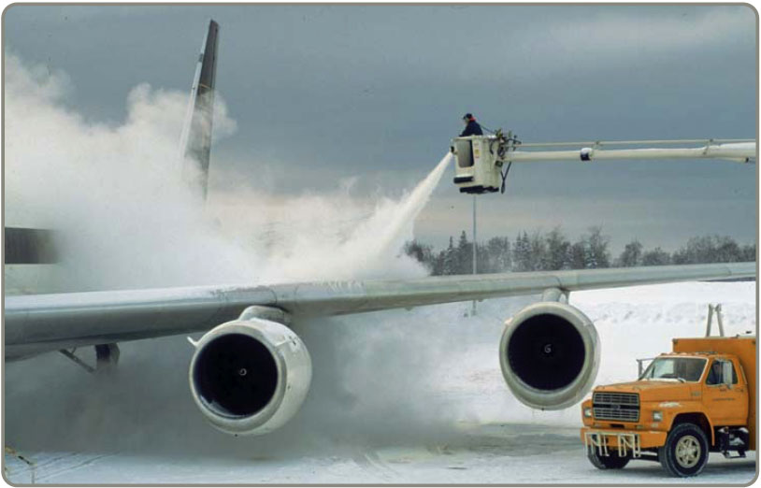
LP Applications
Developing a production schedule that will satisfy future demands for a firm’s product and at the same time minimize total production and inventory costs
Allocating space for a tenant mix in a new shopping mall
so as to maximize
revenues to the
leasing company
Notes:
This slide can be used to frame a discussion of capacity.
Points to be made might include:
- capacity definition and measurement is necessary if we are to develop a production schedule
- while a process may have “maximum” capacity, many factors prevent us from achieving that capacity on a continuous basis.
Students should be asked to suggest factors which might prevent one from achieving maximum capacity.

Slide 12
Requirements of an
LP Problem
LP problems seek to maximize or minimize some quantity (usually profit or cost) expressed as an objective function
The presence of restrictions, or constraints, limits the degree to which we can pursue our objective
Notes:
This slide can be used to frame a discussion of capacity.
Points to be made might include:
- capacity definition and measurement is necessary if we are to develop a production schedule
- while a process may have “maximum” capacity, many factors prevent us from achieving that capacity on a continuous basis.
Students should be asked to suggest factors which might prevent one from achieving maximum capacity.

Slide 13
Requirements of an
LP Problem
There must be alternative courses of action to choose from
The objective and constraints in linear programming problems must be expressed in terms of linear equations or inequalities
Notes:
This slide can be used to frame a discussion of capacity.
Points to be made might include:
- capacity definition and measurement is necessary if we are to develop a production schedule
- while a process may have “maximum” capacity, many factors prevent us from achieving that capacity on a continuous basis.
Students should be asked to suggest factors which might prevent one from achieving maximum capacity.

Slide 14
Formulating LP Problems
The product-mix problem at Shader Electronics
Two products
  Shader x-pod, a portable music player
  Shader BlueBerry, an internet-connected color telephone
Determine the mix of products that will produce the maximum profit

Slide 15
Formulating LP Problems
Hours Required
to Produce 1 Unit
x-pods BlueBerrys Available Hours
Department (X₁) (X₂) This Week
Electronic 4 3 240
Assembly 2 1 100
Profit per unit $7 $5
Table B.1
Decision Variables:
X₁ = number of x-pods to be produced
X₂ = number of BlueBerrys to be produced

Slide 16
Formulating LP Problems
Objective Function:
Maximize Profit = $7X₁ + $5X₂
There are three types of constraints
Upper limits where the amount used is ≤ the amount of a resource
Lower limits where the amount used is ≥ the amount of the resource
Equalities where the amount used is = the amount of the resource

Slide 17
Formulating LP Problems
First Constraint:
Electronic
time used
Electronic
time available
is ≤
4X₁ + 3X₂ ≤ 240 (hours of electronic time)
Second Constraint:
Assembly
time used
Assembly
time available
is ≤
2X₁ + 1X₂ ≤ 100 (hours of assembly time)

Slide 18
Graphical Solution
Can be used when there are two decision variables
  Plot the constraint equations at their limits by converting each equation to an equality
  Identify the feasible solution space
  Create an iso-profit line based on the objective function
  Move this line outwards until the optimal point is identified

Slide 19
Graphical Solution
X₂
–
–
80 –
–
60 –
–
40 –
–
20 –
–
–
Assembly (Constraint B)
Number of BlueBerrys
Electronics (Constraint A)
Feasible region
| | | | | | | | | | |
0 20 40 60 80 100
X₁
Figure B.3
Number of x-pods

Slide 20
Graphical Solution
X₂
Iso-Profit Line Solution Method
–
–
80 –
–
60 –
–
40 –
–
20 –
–
–
Choose a possible value for the objective function
Assembly (Constraint B)
$210 = 7X₁ + 5X₂
Number of BlueBerrys
Solve for the axis intercepts of the function and plot the line
Electronics (Constraint A)
Feasible region
X₂ = 42 X₁ = 30
| | | | | | | | | | |
0 20 40 60 80 100
X₁
Figure B.3
Number of x-pods

Slide 21
Graphical Solution
X₂
–
–
80 –
–
60 –
–
40 –
–
20 –
–
–
$210 = $7X₁ + $5X₂
Number of BlueBerrys
(0, 42)
(30, 0)
| | | | | | | | | | |
0 20 40 60 80 100
X₁
Figure B.4
Number of x-pods

Slide 22
Graphical Solution
X₂
–
–
80 –
–
60 –
–
40 –
–
20 –
–
–
$350 = $7X₁ + $5X₂
$280 = $7X₁ + $5X₂
$210 = $7X₁ + $5X₂
Number of BlueBerrys
$420 = $7X₁ + $5X₂
| | | | | | | | | | |
0 20 40 60 80 100
X₁
Figure B.5
Number of x-pods

Slide 23
Graphical Solution
X₂
–
–
80 –
–
60 –
–
40 –
–
20 –
–
–
Maximum profit line
Optimal solution point
(X₁ = 30, X₂ = 40)
Number of BlueBerrys
$410 = $7X₁ + $5X₂
| | | | | | | | | | |
0 20 40 60 80 100
X₁
Figure B.6
Number of x-pods

Slide 24
Corner-Point Method
X₂
–
–
80 –
–
60 –
–
40 –
–
20 –
–
–
2
Number of BlueBerrys
3
1
| | | | | | | | | | |
0 20 40 60 80 100
X₁
4
Figure B.7
Number of x-pods

Slide 25
Corner-Point Method
The optimal value will always be at a corner point
Find the objective function value at each corner point and choose the one with the highest profit
Point 1 : (X₁ = 0, X₂ = 0) Profit $7(0) + $5(0) = $0
Point 2 : (X₁ = 0, X₂ = 80) Profit $7(0) + $5(80) = $400
Point 4 : (X₁ = 50, X₂ = 0) Profit $7(50) + $5(0) = $350

Slide 26
Corner-Point Method
The optimal value will always be at a corner point
Find the objective function value at each corner point and choose the one with the highest profit
Solve for the intersection of two constraints
4X₁ + 3X₂ ≤ 240 (electronics time)
2X₁ + 1X₂ ≤ 100 (assembly time)
4X₁ + 3X₂ = 240
- 4X₁ - 2X₂ = -200
+ 1X₂ = 40
4X₁ + 3(40) = 240
4X₁ + 120 = 240
X₁ = 30
Point 1 : (X₁ = 0, X₂ = 0) Profit $7(0) + $5(0) = $0
Point 2 : (X₁ = 0, X₂ = 80) Profit $7(0) + $5(80) = $400
Point 4 : (X₁ = 50, X₂ = 0) Profit $7(50) + $5(0) = $350

Slide 27
Corner-Point Method
The optimal value will always be at a corner point
Find the objective function value at each corner point and choose the one with the highest profit
Point 1 : (X₁ = 0, X₂ = 0) Profit $7(0) + $5(0) = $0
Point 2 : (X₁ = 0, X₂ = 80) Profit $7(0) + $5(80) = $400
Point 4 : (X₁ = 50, X₂ = 0) Profit $7(50) + $5(0) = $350
Point 3 : (X₁ = 30, X₂ = 40) Profit $7(30) + $5(40) = $410

Slide 28
Sensitivity Analysis
How sensitive the results are to parameter changes
  Change in the value of coefficients
  Change in a right-hand-side value of a constraint
Trial-and-error approach
Analytic postoptimality method

Slide 29
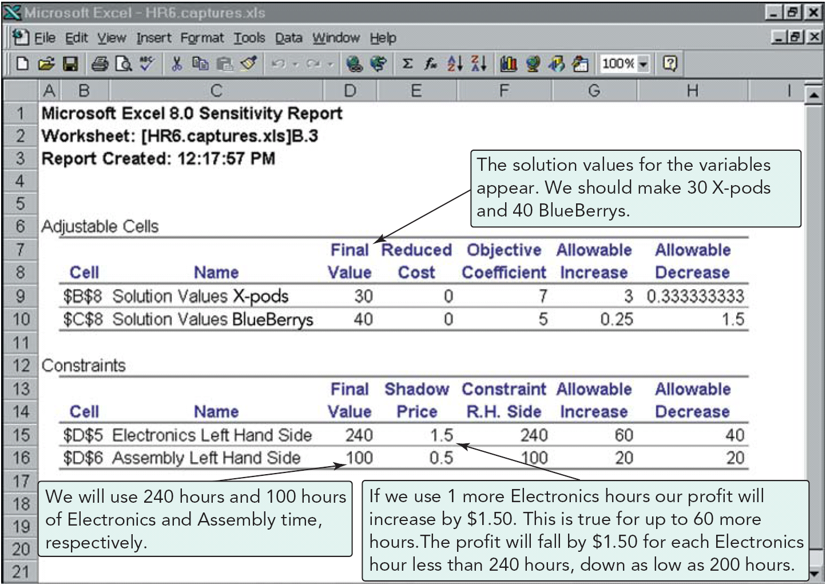
Sensitivity Report
Program B.1

Slide 30
Changes in Resources
The right-hand-side values of constraint equations may change as resource availability changes
The shadow price of a constraint is the change in the value of the objective function resulting from a one-unit change in the right-hand-side value of the constraint

Slide 31
Changes in Resources
Shadow prices are often explained as answering the question “How much would you pay for one additional unit of a resource?”
Shadow prices are only valid over a particular range of changes in right-hand-side values
Sensitivity reports provide the upper and lower limits of this range

Slide 32
Sensitivity Analysis
X₂
–
100 –
–
80 –
–
60 –
–
40 –
–
20 –
–
–
Changed assembly constraint from 2X₁ + 1X₂ = 100
to 2X₁ + 1X₂ = 110
2
Corner point 3 is still optimal, but values at this point are now X₁ = 45, X₂ = 20, with a profit = $415
Electronics constraint is unchanged
3
1
| | | | | | | | | | |
0 20 40 60 80 100
4
X₁
Figure B.8 (a)

Slide 33
Sensitivity Analysis
X₂
–
100 –
–
80 –
–
60 –
–
40 –
–
20 –
–
–
Changed assembly constraint from 2X₁ + 1X₂ = 100
to 2X₁ + 1X₂ = 90
2
Corner point 3 is still optimal, but values at this point are now X₁ = 15, X₂ = 60, with a profit = $405
3
Electronics constraint is unchanged
1
| | | | | | | | | | |
0 20 40 60 80 100
4
X₁
Figure B.8 (b)

Slide 34
Changes in the
Objective Function
A change in the coefficients in the objective function may cause a different corner point to become the optimal solution
The sensitivity report shows how much objective function coefficients may change without changing the optimal solution point

Slide 35
Solving Minimization Problems
Formulated and solved in much the same way as maximization problems
In the graphical approach an iso-cost line is used
The objective is to move the iso-cost line inwards until it reaches the lowest cost corner point
Notes:
It might be useful at this point to discuss typical equipment utilization rates for different process strategies if you have not done so before.

Slide 36
Minimization Example
X₁ = number of tons of black-and-white picture chemical produced
X₂ = number of tons of color picture chemical produced
Minimize total cost = 2,500X₁ + 3,000X₂
Subject to:
X₁ ≥ 30 tons of black-and-white chemical
X₂ ≥ 20 tons of color chemical
X₁ + X₂ ≥ 60 tons total
X₁, X₂ ≥ $0 nonnegativity requirements
Notes:
It might be useful at this point to discuss typical equipment utilization rates for different process strategies if you have not done so before.

Slide 37
Minimization Example
Table B.9
X₂
60 –
50 –
40 –
30 –
20 –
10 –
–
X₁ + X₂ = 60
Feasible region
b
a
X₁ = 30
X₂ = 20
| | | | | | |
0 10 20 30 40 50 60
X₁
Notes:
It might be useful at this point to discuss typical equipment utilization rates for different process strategies if you have not done so before.

Slide 38
Minimization Example
Total cost at a = 2,500X₁ + 3,000X₂
= 2,500 (40) + 3,000(20)
= $160,000
Total cost at b = 2,500X₁ + 3,000X₂
= 2,500 (30) + 3,000(30)
= $165,000
Lowest total cost is at point a
Notes:
It might be useful at this point to discuss typical equipment utilization rates for different process strategies if you have not done so before.

Slide 39
LP Applications
Production-Mix Example
Department
Product Wiring Drilling Assembly Inspection Unit Profit
XJ201 .5 3 2 .5 $ 9
XM897 1.5 1 4 1.0 $12
TR29 1.5 2 1 .5 $15
BR788 1.0 3 2 .5 $11
Capacity Minimum
Department (in hours) Product Production Level
Wiring 1,500 XJ201 150
Drilling 2,350 XM897 100
Assembly 2,600 TR29 300
Inspection 1,200 BR788 400

Slide 40
LP Applications
X₁ = number of units of XJ201 produced
X₂ = number of units of XM897 produced
X₃ = number of units of TR29 produced
X₄ = number of units of BR788 produced
Maximize profit = 9X₁ + 12X₂ + 15X₃ + 11X₄
subject to .5X₁ + 1.5X₂ + 1.5X₃ + 1X₄ ≤ 1,500 hours of wiring
3X₁ + 1X₂ + 2X₃ + 3X₄ ≤ 2,350 hours of drilling
2X₁ + 4X₂ + 1X₃ + 2X₄ ≤ 2,600 hours of assembly
.5X₁ + 1X₂ + .5X₃ + .5X₄ ≤ 1,200 hours of inspection
X₁ ≥ 150 units of XJ201
X₂ ≥ 100 units of XM897
X₃ ≥ 300 units of TR29
X₄ ≥ 400 units of BR788

Slide 41
LP Applications
Diet Problem Example
Feed
Product Stock X Stock Y Stock Z
A 3 oz 2 oz 4 oz
B 2 oz 3 oz 1 oz
C 1 oz 0 oz 2 oz
D 6 oz 8 oz 4 oz

Slide 42
LP Applications
X₁ = number of pounds of stock X purchased per cow each month
X₂ = number of pounds of stock Y purchased per cow each month
X₃ = number of pounds of stock Z purchased per cow each month
Minimize cost = .02X₁ + .04X₂ + .025X₃
Ingredient A requirement: 3X₁ + 2X₂ + 4X₃ ≥ 64
Ingredient B requirement: 2X₁ + 3X₂ + 1X₃ ≥ 80
Ingredient C requirement: 1X₁ + 0X₂ + 2X₃ ≥ 16
Ingredient D requirement: 6X₁ + 8X₂ + 4X₃ ≥ 128
Stock Z limitation: X₃ ≤ 80
X_{1,} X_{2,} X₃ ≥ 0
Cheapest solution is to purchase 40 pounds of grain X
at a cost of $0.80 per cow

Slide 43
LP Applications
Labor Scheduling Example
Time Number of Time Number of
Period Tellers Required Period Tellers Required
9 AM - 10 AM 10 1 PM - 2 PM 18
10 AM - 11 AM 12 2 PM - 3 PM 17
11 AM - Noon 14 3 PM - 4 PM 15
Noon - 1 PM 16 4 PM - 5 PM 10
F = Full-time tellers
P₁ = Part-time tellers starting at 9 AM (leaving at 1 PM)
P₂ = Part-time tellers starting at 10 AM (leaving at 2 PM)
P₃ = Part-time tellers starting at 11 AM (leaving at 3 PM)
P₄ = Part-time tellers starting at noon (leaving at 4 PM)
P₅ = Part-time tellers starting at 1 PM (leaving at 5 PM)

Slide 44
LP Applications
Minimize total daily
manpower cost
= $75F + $24(P₁ + P₂ + P₃ + P₄ + P₅)
F + P₁ ≥ 10 (9 AM - 10 AM needs)
F + P₁ + P₂ ≥ 12 (10 AM - 11 AM needs)
1/2 F + P₁ + P₂ + P₃ ≥ 14 (11 AM - 11 AM needs)
1/2 F + P₁ + P₂ + P₃ + P₄ ≥ 16 (noon - 1 PM needs)
F + P₂ + P₃ + P₄ + P₅ ≥ 18 (1 PM - 2 PM needs)
F + P₃ + P₄ + P₅ ≥ 17 (2 PM - 3 PM needs)
F + P₄ + P₅ ≥ 15 (3 PM - 7 PM needs)
F + P₅ ≥ 10 (4 PM - 5 PM needs)
F ≤ 12
4(P₁ + P₂ + P₃ + P₄ + P₅) ≤ .50(10 + 12 + 14 + 16 + 18 + 17 + 15 + 10)

Slide 45
LP Applications
Minimize total daily
manpower cost
= $75F + $24(P₁ + P₂ + P₃ + P₄ + P₅)
F + P₁ ≥ 10 (9 AM - 10 AM needs)
F + P₁ + P₂ ≥ 12 (10 AM - 11 AM needs)
1/2 F + P₁ + P₂ + P₃ ≥ 14 (11 AM - 11 AM needs)
1/2 F + P₁ + P₂ + P₃ + P₄ ≥ 16 (noon - 1 PM needs)
F + P₂ + P₃ + P₄ + P₅ ≥ 18 (1 PM - 2 PM needs)
F + P₃ + P₄ + P₅ ≥ 17 (2 PM - 3 PM needs)
F + P₄ + P₅ ≥ 15 (3 PM - 7 PM needs)
F + P₅ ≥ 10 (4 PM - 5 PM needs)
F ≤ 12
4(P₁ + P₂ + P₃ + P₄ + P₅ ) ≤ .50(112)
F, P₁, P₂ , P₃ , P₄, P₅ ≥ 0

Slide 46
LP Applications
There are two alternate optimal solutions to this problem but both will cost $1,086 per day
First Second
Solution Solution
F = 10 F = 10
P₁ = 0 P₁ = 6
P₂ = 7 P₂ = 1
P₃ = 2 P₃ = 2
P₄ = 2 P₄ = 2
P₅ = 3 P₅ = 3

Slide 47
The Simplex Method
Real world problems are too complex to be solved using the graphical method
The simplex method is an algorithm for solving more complex problems
Developed by George Dantzig in the late 1940s
Most computer-based LP packages use the simplex method

Slide 48

All rights reserved. No part of this publication may be reproduced, stored in a retrieval system, or transmitted, in any form or by any means, electronic, mechanical, photocopying, recording, or otherwise, without the prior written permission of the publisher.
Printed in the United States of America.

